Slide 1
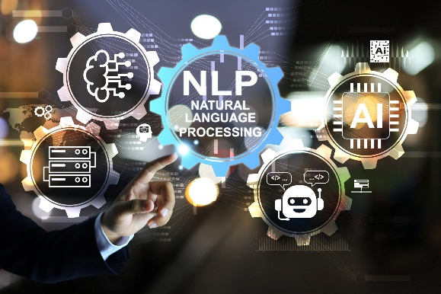

Dr. Muzamil Ahmed (Assistant Professor) Namal University Mianwali
Natural Language Processing
Large Language Model (LLM) Agents

Slide 2

Lesson from Quran

Slide 3

Lecture Outline
Introduction LLM Agents
What Makes an LLM an Agent?
Components of an LLM Agent
Agent Architecture
Tools, Schemas & Function Calling
Memory in Agents
Chain-of-Thought Reasoning
Agent Frameworks

Slide 4
Introduction LLM Agents
Large language models began as next-token predictors.
Agents are what happens when you surround that predictor with memory, tools, and a feedback loop, turning a static model into a system that can plan, act, observe, and iterate toward a goal across many steps.
Definition: "An LLM agent is a language model coupled with an environment it can perceive and act upon, driven by an objective that may require many inference calls to satisfy."
Prerequisites: Familiarity with transformer attention, autoregressive decoding, prompt engineering basics, and at least one LLM API.

Slide 5
What Makes an LLM an Agent?
A bare LLM call is a pure function: text in, text out. An agent is an agent loop
A program that repeatedly feeds observations into the model, receives actions, executes them, and feeds back results. The model is the policy; the loop is the runtime.
Perception: The agent receives structured state: user messages, tool outputs, retrieved documents, or environment observations. All context is serialized into the context window.
Policy (LLM Inference): The model generates the next action i.e., a tool call, a sub-task delegation, an answer, or a chain-of-thought reasoning step conditioned on the entire accumulated context.
Action Execution: Actions are dispatched to executors: API wrappers, code interpreters, database queries, browser automations. Results are typed observations returned to the loop.
Termination: The loop ends when the model emits a FINISH action, a budget (token or step count) is exhausted, or a human-in-the-loop checkpoint is reached.
state_{t+1} = Exec( action_t ), action_t = LLM( system_prompt ⊕ history_{0..t} )

Slide 6
Motivation: Why Do We Need Agents?
Traditional LLMs such as GPT, Claude, Gemini, and Llama are powerful language generators, but they suffer from several limitations:
Traditional LLM Workflow
User → Prompt → LLM → Response
Characteristics:
Single forward-pass prediction
No persistent memory
No external actions
No environment interaction
Cannot autonomously achieve long-term goals

Slide 7
Motivation: Why Do We Need Agents?
Example: User: Book me the cheapest flight to Dubai next month.
A traditional LLM can:
Suggest websites
Explain booking procedures
A traditional LLM cannot:
Search flights
Compare prices
Make reservations
Monitor price changes

Slide 8
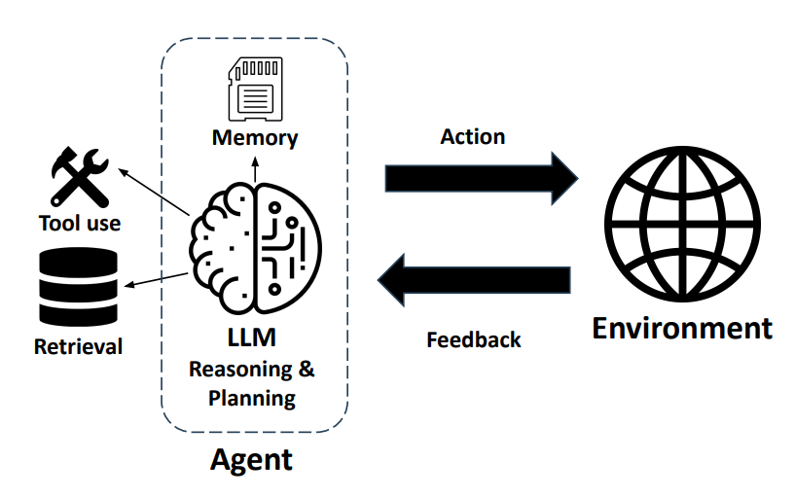
What is an LLM Agent?
An LLM Agent is an AI system that uses a Large Language Model as its reasoning engine and is capable of:
Understanding goals
Planning actions
Using external tools
Accessing memory
Interacting with environments
Monitoring progress
Adapting strategies
An agent can be represented as:
Agent = LLM + Memory + Tools + Planning + Environment

Slide 9
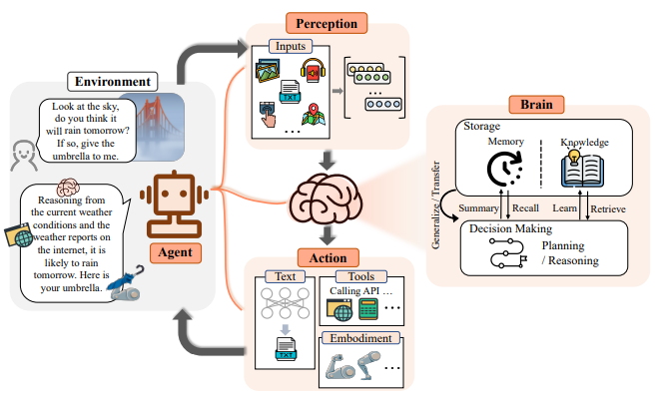
What is an LLM Agent?

Slide 10
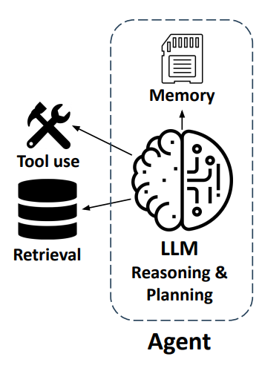
Why empowering LLMs with the agent framework
Solving real-world tasks typically involves a trial-and-error process
Leveraging external tools and retrieving from external knowledge expand LLM’s capabilities
Agent workflow facilitates complex tasks
Task decomposition
Allocation of subtasks to specialized modules
Division of labor for project collaboration
Multi-agent generation inspires better responses

Slide 11
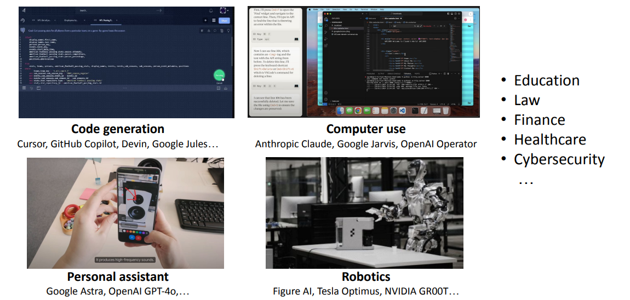
LLM agents transformed various applications

Slide 12
Components of an LLM Agent
Core Components
LLM Core
Planning Module
Memory Module
Tool Interface
Environment
Execution Engine
Reflection Module
User Goal
Planning Module
Reasoning Engine (LLM)
Tool Selection
External Tools
Environment Feedback
Memory Update
Final Output

Slide 13
Agent Architecture
A modern agent consists of four interconnected layers:
Layer 1: Perception
Receives: User prompts, Documents , APIs or Sensor data
Layer 2: Cognition
Responsible for: Reasoning, Planning, Decision making, Implemented using LLMs.
Layer 3: Action
Uses: APIs, Databases, Search engines, Software systems
Layer 4: Memory
Stores: Past conversations, Experiences, Learned strategies

Slide 14
ReAct: Reasoning + Acting
ReAct (Yao et al., 2023) interleaves chain-of-thought reasoning traces with concrete action invocations in the same token stream. The key insight: making reasoning explicit keeps the model grounded, reduces hallucinated tool outputs, and leaves an auditable trace.
# ReAct prompt structure (simplified) """ Thought: I need to find the current population of Lagos. Action: search("Lagos Nigeria population 2024") Observation: Lagos metro area population is approximately 15.9 million (UN 2024). Thought: I now have the figure. I can answer. Action: finish("Lagos has ~15.9 million people in its metro area.") """
Why reasoning traces matter
Without explicit Thought tokens, models frequently hallucinate Observation values essentially inventing tool results.
Forcing a reasoning step before each action dramatically lowers this rate.

Slide 15
Tools, Schemas & Function Calling
Modern LLM APIs expose a tools parameter that accepts JSON Schema descriptors. The model is trained to emit structured tool_use blocks instead of free text when it decides an action is needed. This replaces brittle regex parsing with native structured outputs.
Example:
# Minimal tool schema (Anthropic format) tools = [{ "name": "get_weather", "description": "Returns current temperature and conditions for a city.", "input_schema": { "type": "object", "properties": { "city": {"type": "string", "description": "City name, e.g. 'Karachi'"}, "unit": {"type": "string", "enum": ["celsius", "fahrenheit"]} }, "required": ["city"] } }]

Slide 16
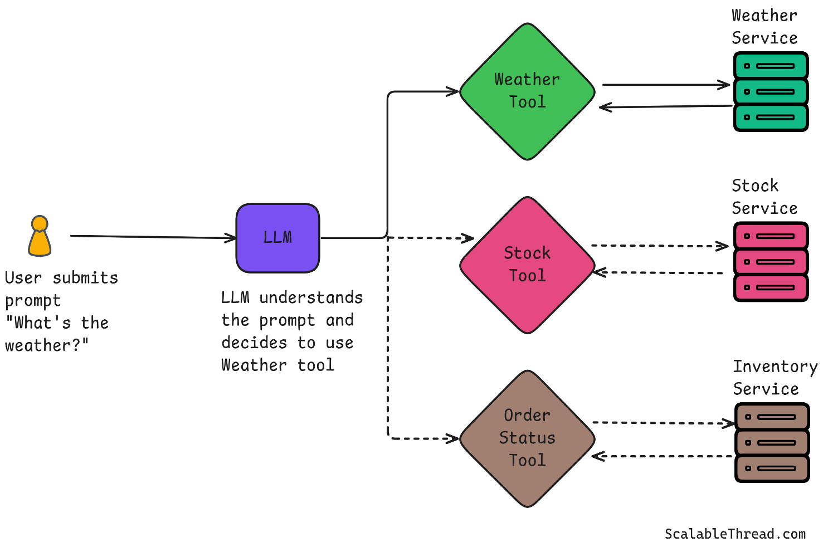
Tools, Schemas & Function Calling
Tool selection
The model learns from RLHF which tool fits which intent. Good descriptions are critical — they are literally part of the prompt the model sees.
Parallel calls
GPT-4o and Claude 3 support multiple simultaneous tool calls in one response. Independent actions (e.g., fetch two APIs) should always be parallelized.
Result injection
Tool results are sent back as a tool_result message with the matching tool_use_id. The model never "remembers" results across turns on its own.

Slide 17
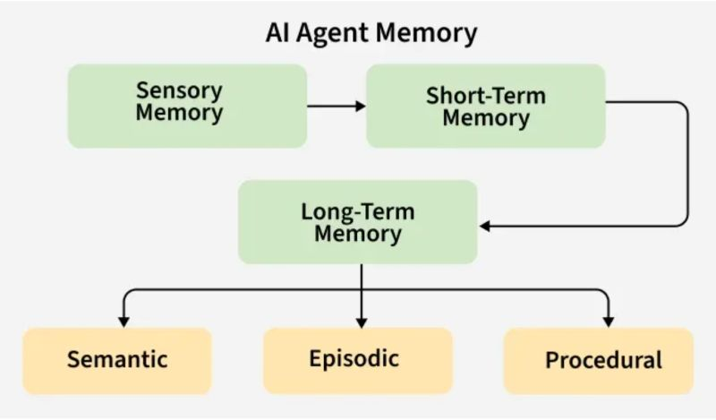
Memory in Agents
Human intelligence relies heavily on memory.
Agents require memory for:
Context retention
Personalization
Long-term learning
Multi-session continuity
Without memory:
Every interaction starts from scratch.

Slide 18
The Four Kinds of Agent Memory
LLMs have no persistent state between API calls. Every form of memory in an agent is engineered by the system designer. There are four canonical layers, each with different access latency, capacity, and mutability.
Layer | Mechanism | Capacity | Typical use
In-context | Tokens in the active context window | 8k–200k tokens | Working memory; current conversation; recent tool outputs
External (semantic) | Vector DB (FAISS, Pinecone, pgvector) + embedding retrieval | Millions of chunks | Long-term knowledge, documentation, past conversation summaries
External (episodic) | Structured DB; key-value store | Essentially unlimited | Task history, user preferences, prior action traces
In-weights | Fine-tuning / LoRA adapters | Bounded by model capacity | Domain knowledge, tool usage patterns, stylistic norms

Slide 19
Planning
Planning is the ability to decompose a high-level goal into a sequence of executable sub-steps before acting.
The sophistication of the planner determines how well an agent handles tasks with long horizons, dependencies, or ambiguous state.
Goal: Build NLP Research Survey
Without Planning Result: Single response generation
With Planning Subtasks:
Search literature
Categorize papers
Analyze methodologies
Compare results
Write report
Planning transforms complex tasks into manageable units.

Slide 20
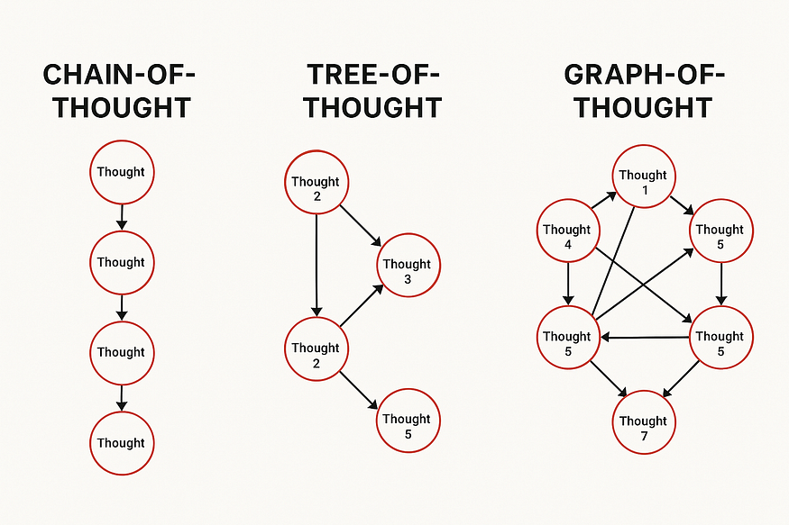
Chain-of-Thought Reasoning
Chain-of-Thought (CoT) enables explicit reasoning.
Linear decomposition.
The model generates a step-by-step plan in a single forward pass. Fast and cheap but commits irrevocably.
A wrong step early propagates through the whole plan.
Works well for tasks with low ambiguity and clear sub-task ordering.

Slide 21
Tree-of-Thought (ToT)
Chain-of-Thought explores a single reasoning path.
Tree-of-Thought explores multiple reasoning paths.
Branching + evaluation.
The model generates multiple candidate continuations at each step, scores them (often via a second LLM call), and prunes.
Implements best-first or beam search over the space of reasoning paths.
Expensive: O(b×d) LLM calls for beam width b and depth d.
Advantages:
Better exploration
Reduced reasoning errors
Enhanced decision quality

Slide 22
Task Graphs
Real workflows often have parallel branches and data dependencies. Representing the plan as a DAG (directed acyclic graph).
Let's an orchestrator schedule independent tasks concurrently and re-plan after partial failures without restarting from scratch.
Plan = DAG(V=tasks, E=dependencies) Ready(t) = all predecessors completed
Systems like LangGraph and DSPy's compiler generate such graphs automatically from high-level task descriptions, using the LLM as both planner and sub-task executor.

Slide 23
Orchestrators, Subagents & Handoff Protocols
Single-agent loops hit hard limits on context length, specialization, and parallelism.
Multi-agent systems decompose work across specialized agents coordinated by an orchestrator that routes tasks, aggregates results, and resolves conflicts.
Hierarchical (Manager-Worker): An orchestrator LLM receives the top-level goal, decomposes it, and dispatches sub-tasks to worker agents via tool calls. Workers return structured results. The orchestrator synthesizes and decides whether to iterate or terminate.
Peer-to-peer (Debate / Critique): Agents running in parallel generate independent solutions, then critique each other's outputs. Used in Constitutional AI refinement loops and Reflexion-style self-correction. Requires a merge step that itself calls an LLM.

Slide 24
Reflexion: Verbal Reinforcement Learning
Reflexion (Shinn et al., 2023) is an agent architecture where the model evaluates its own failed trajectories
Produces a natural-language critique stored in long-term memory, and uses those critiques to avoid repeating errors in subsequent episodes without any gradient updates.
# Simplified Reflexion loop
def reflexion_loop(task, max_trials=3):
memory = []
for trial in range(max_trials):
trajectory = run_agent(task, prior_reflections=memory)
score = evaluate(trajectory)
# env reward or LLM judge
if score == SUCCESS:
return
trajectory reflection = llm(f"You tried: {trajectory}. Score: {score}. What went wrong and how would you fix it?")
memory.append(reflection)
# persisted across trials
return best_so_far(trajectories)

Slide 25
Agent Communication
Agents exchange information through:
Messages
Shared memory
Knowledge graphs
Event systems
Example:
Research Agent: "Found 20 papers."
Writing Agent: "Generate survey draft."
Review Agent: "Identify missing sections."

Slide 26
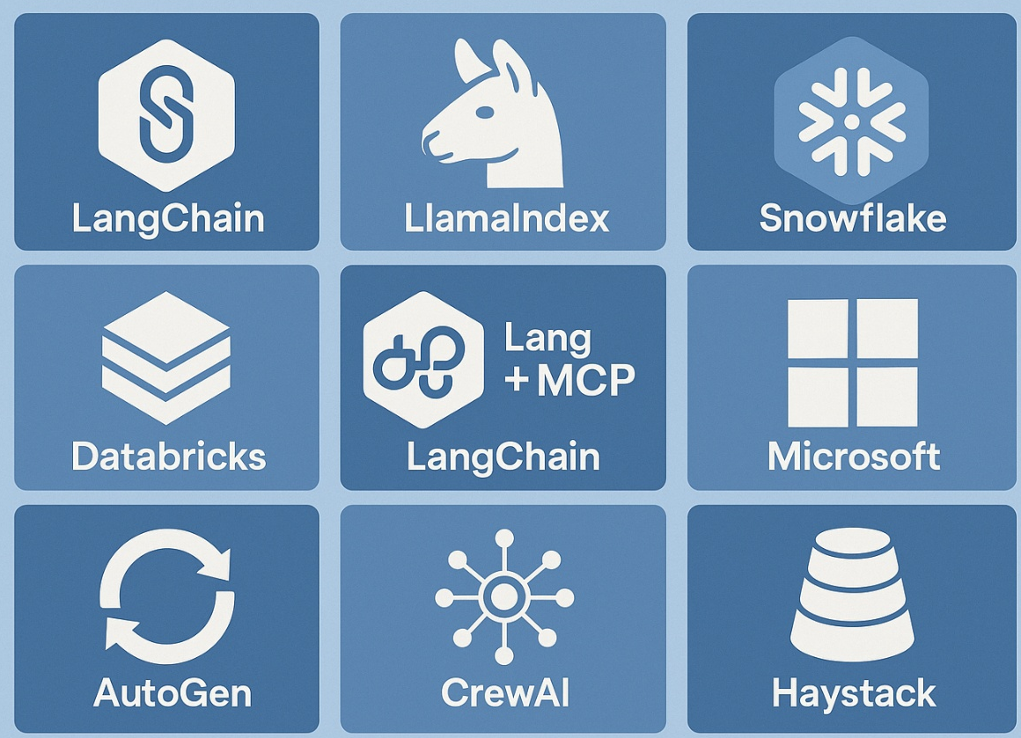
Agent Frameworks (Popular frameworks)
LangChain
Components: Chains, Tools, Memory, Agents
LangGraph
Supports: Stateful workflows, Multi-agent systems
AutoGen
Developed by: Microsoft
Focus: Agent collaboration
CrewAI
Role-based agents.

Slide 27
What Goes Wrong & How to Mitigate It
Agent failures are qualitatively different from single-call failures because they compound oversteps, can trigger irreversible side effects, and are harder to detect without explicit monitoring.
Here are the dominant failure modes in production deployments.
Failure Mode | Mechanism | Mitigation
Infinite loops | Model re-invokes the same failing tool, or misidentifies FINISH conditions | Hard step budget, loop detection (hash recent (action, observation) pairs), forced termination
Hallucinated tool calls | Model generates a call to a non-existent tool or with fabricated arguments | Strict JSON schema validation; return explicit error observation; never silently drop bad calls
Prompt injection | Adversarial text in retrieved documents or tool outputs hijacks agent behavior | Separate instruction and data channels; sanitize retrieved content; privilege-level checking
Context overflow | Accumulating history exceeds context window; earlier instructions are forgotten | Sliding window with summarization; episodic compression; tool output truncation policies
Irreversible actions | Agent deletes data, sends emails, charges payments before verifying | Staged execution: plan → human approval → execute. Soft vs. hard tool tiers. Dry-run mode.

Slide 28
Evaluating Agents
Evaluating agents is far harder than evaluating single LLM outputs. The state space is exponentially larger, trajectories matter (not just final answers), and many tasks lack a ground-truth reference.
The field is rapidly converging on a set of benchmark categories.
Task completion: Did the agent achieve the goal? Measured against test suites (SWE-bench for coding, WebArena for web agents, GAIA for general assistants). Binary or partial-credit scoring.
Efficiency: Steps taken, tokens consumed, wall-clock time, and API cost per completed task. A 90% success rate at 100× cost is usually not deployable.
Robustness: Performance under adversarial inputs, tool failures, noisy observations, and out-of-distribution tasks. Pass@k over k random seeds reveals variance.

Slide 29
Challenges in Agentic AI
Hallucinations: Incorrect reasoning.
Tool Misuse: Wrong API selection.
Infinite Loops: Repeated actions.
Context Overflow: Exceeding context window.
Security Risks: Prompt injection attacks.
Reliability: Inconsistent performance.
Open problems: sample-efficient planning, long-horizon memory, reliable self-evaluation, safe exploration in real environments, and interpretable agent traces for debugging.

Slide 30
Security in LLM Agents
Major threats:
Prompt Injection: Malicious instructions embedded in data.
Tool Exploitation: Unauthorized actions.
Data Leakage: Sensitive information exposure.
Memory Poisoning: Corrupted long-term memory.
Mitigation:
Sandboxing
Permission systems
Validation layers

Slide 31
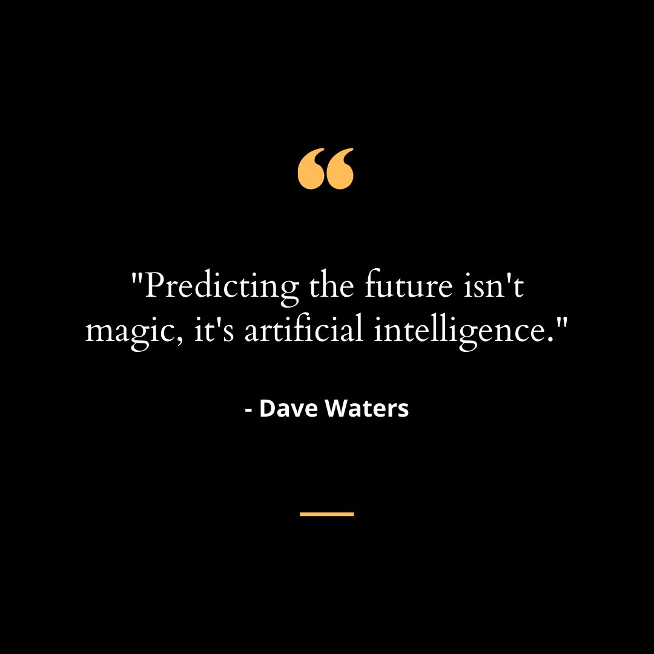
Thanks

